Slide 1
Opioid Epidemic
Analysis on Opioid Deaths
Data Analysis and Visualization Boot Camp at Texas McCombs - Project 1
Minhua Wu, Rachael McLaughlin, Yangzi Xin, Shailaja Madasu
Notes:
Jas

Slide 2
Project Objective
Our project is to understand the trend on opioid deaths in USA from 2011 to 2017. We are achieving this by examining opioid deaths across the states and further exploring demographics of individuals who are dying from opioid use (e.g., income, profession, GDP, unemployment).
Notes:
Jas

Slide 3



Datasets
https://www.kaggle.com/ryanandreweckberg/opioid-crisis-by-interpersonal-relationships#Wide_Master.csv
https://www.kaggle.com/apryor6/us-opiate-prescriptions
Notes:
Shailaja

Slide 4
Background of Dataset
Total death count: The mortality data are based on information from all death certificates filed in the fifty states
https://wonder.cdc.gov/
Population: Annual estimates of the resident population for counties
https://www.census.gov/data/datasets/time-series/demo/popest/2010s-counties-total.html#par_textimage_70769902
GDP Total: By county in regards to funds spent on healthcare, education, and social assistance as well as overall GDP
https://www.bea.gov/data/gdp/gdp-county-metro-and-other-areas
Year: 2011 - 2017
Education: American Community Survey 5-Year Estimates
www.factfinder.census.gov
Unemployment: By county
https://catalog.data.gov/dataset?tags=unemployment-rate
Income: By the mean household income in that county
www.factfinder.census.gov
Prescriber per Speciality : This dataset has the prescriber wrt to speciality which dispenses Opioids
www.kaggle.com/apryor6/us-opiate-prescriptions
Notes:
Shailaja

Slide 5
Process on Data Exploration, Cleanup, Analysis
Cleaned out missing information in blank database
Understanding what the variables mean, particularly “Total”
Is it rate? Or a pure count?
Through trial and error with visualizations, realized needed to consider it as a rate (total/population)
When examining visualizations, discovered that data for Louisiana was taken out
Notes:
Rachael

Slide 6
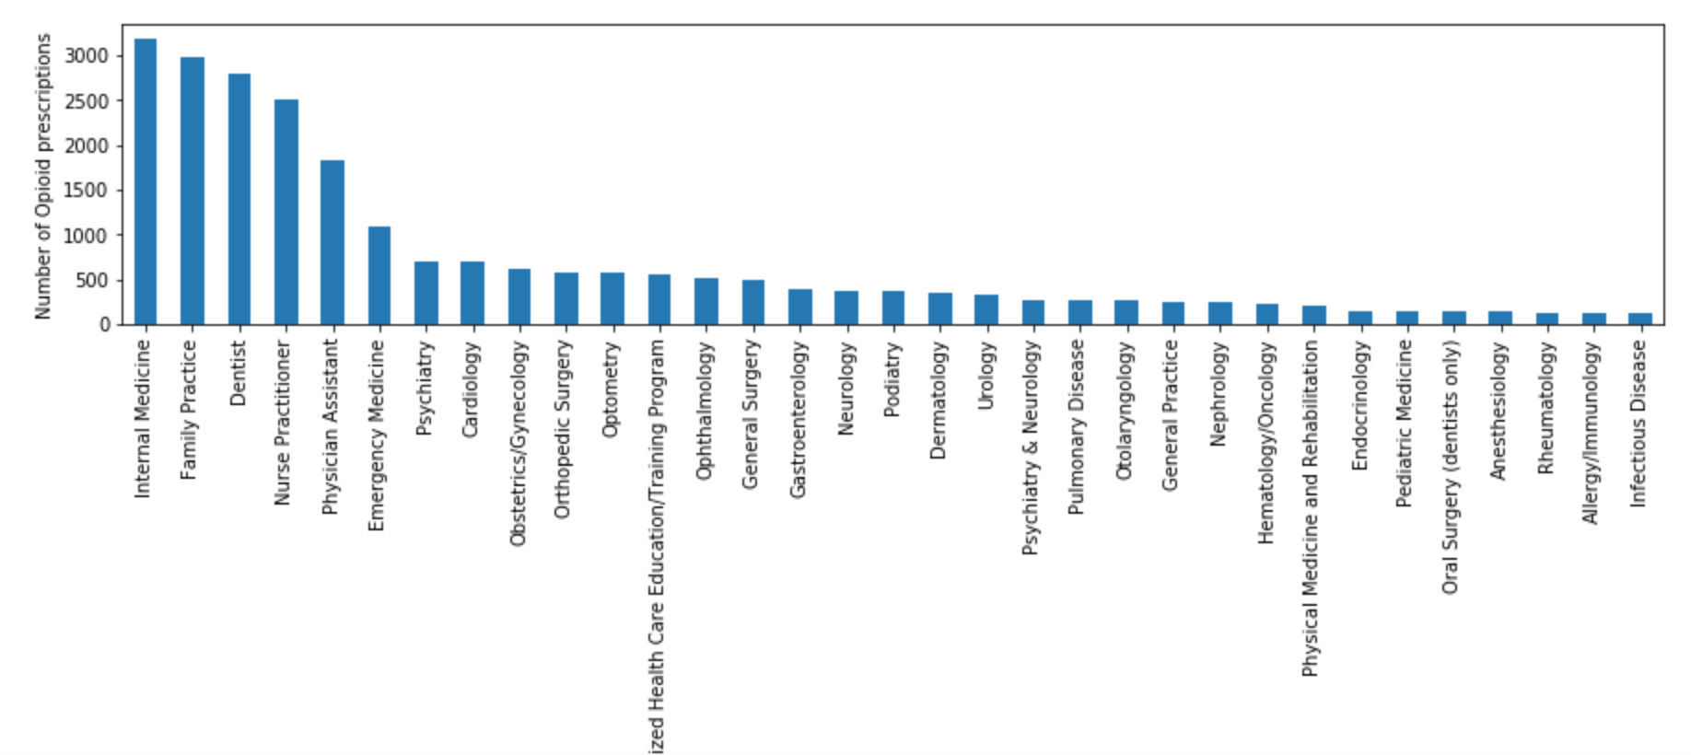
Opioid Prescriptions per Speciality
Drug overdoses account for a significant portion of deaths in United States. Medically, they are used as powerful pain relievers; however, they also produce feelings of euphoria. This makes them highly addictive and prone to abuse. The over dose would suppress the respiration and can lead to Death.
Below graph shows Physicians who prescribe the Opioids in different streams of Speciality. This would give us an idea on which Speciality are using today the maximum opioid drugs used. As of today we do not have a direct link to say how which speciality is causing highest Death rates But we do have the info as to how many these Drugs fall into which Speciality and the below graph would indirectly relate saying that internal medicine might having the highest death rates with Opioids today.
Notes:
Shailaja

Slide 7
Hypothesis Testing
Do death rates differ by the following factors?
States
Years
Income
GDP
Unemployment Rates
Notes:
Minhua

Slide 8
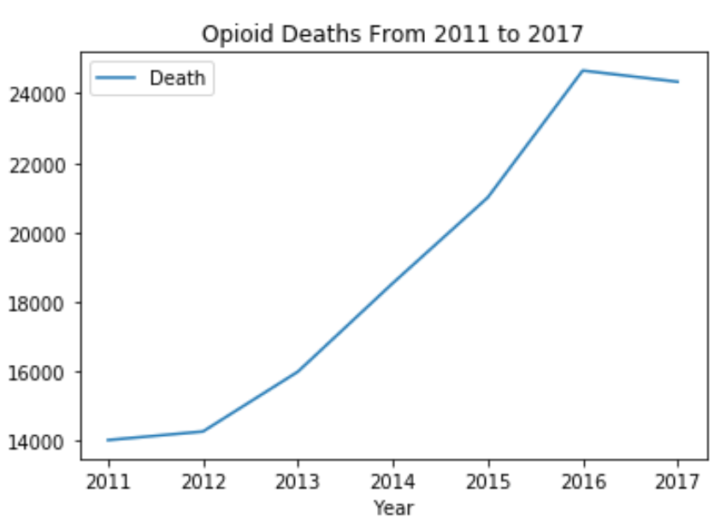
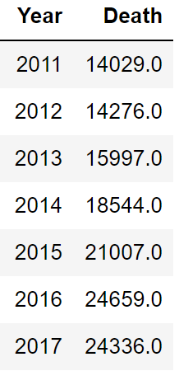
Opioid Deaths from 2011-2017: Increasing Trend
Notes:
Minhua

Slide 9
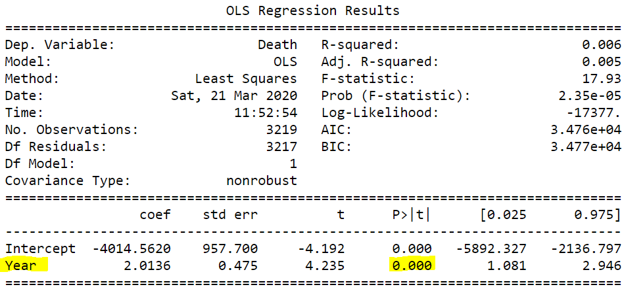
H₀: The death rates do not differ by years.
H_{a}: The death rates differ by years.
Conclusion: Since the p-value is less than 0.05, we reject the null hypothesis and conclude that significant difference does exist in the death rates by years.
Notes:
Minhua

Slide 10
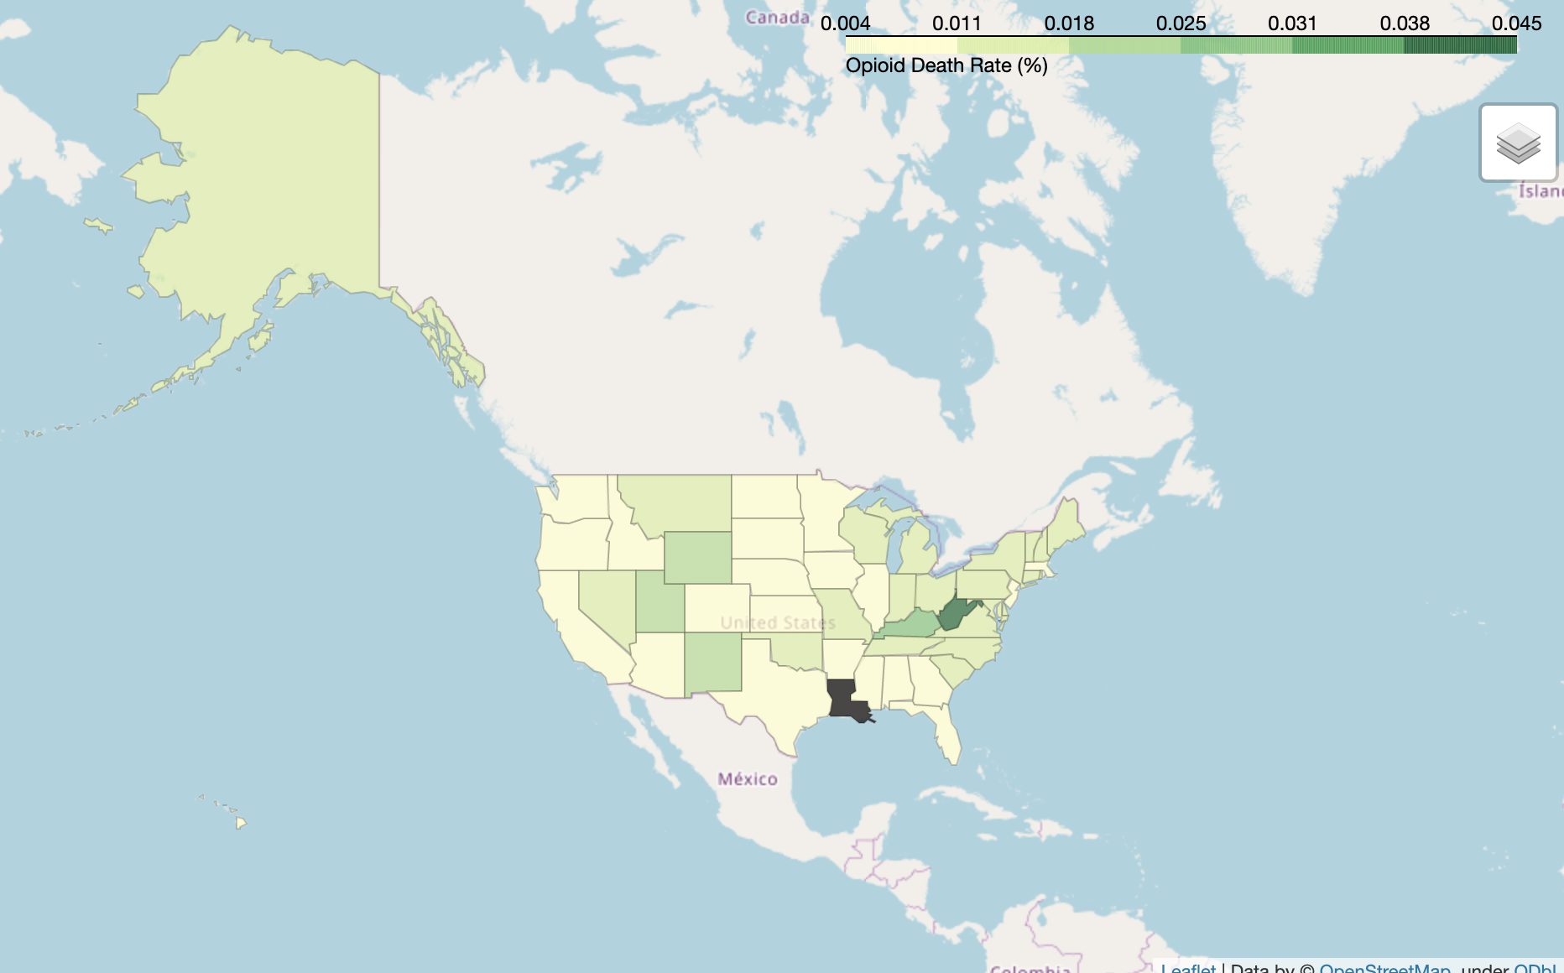
Map of States by Mean Death Rate
Observation:
West Virginia is hit hardest
Louisiana is grayed out because of no data
Notes:
Rachael
Choropleth map

Slide 11
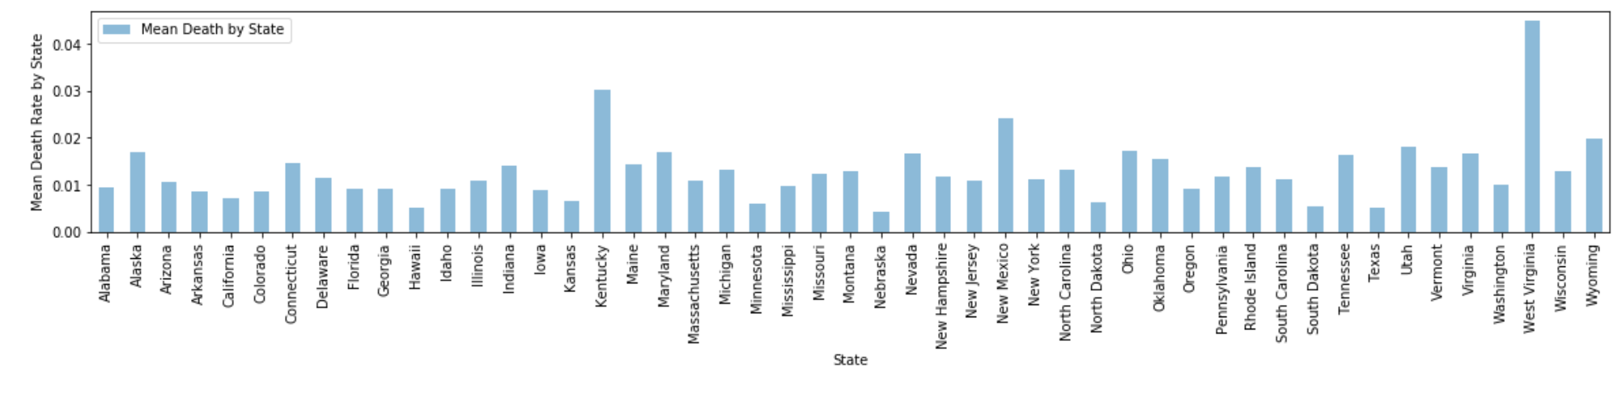
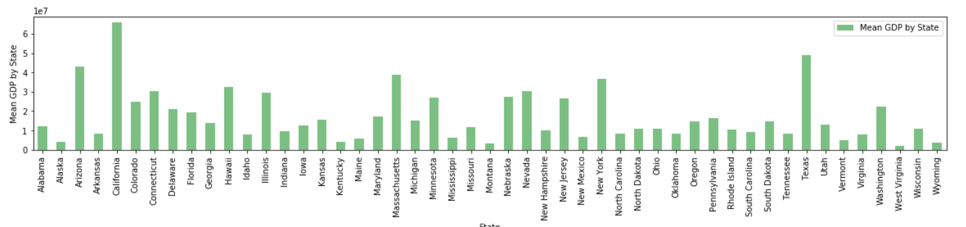
Opioid Death Rate & GDP (mean) by State
Notes:
Jasmine

Slide 12

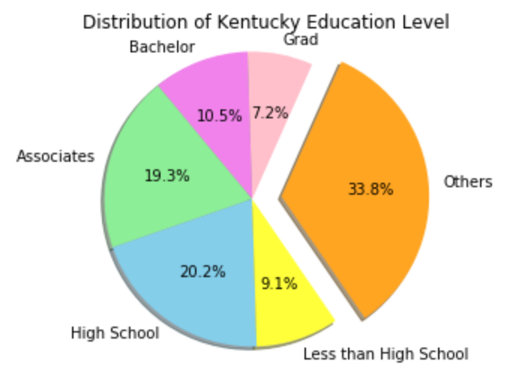
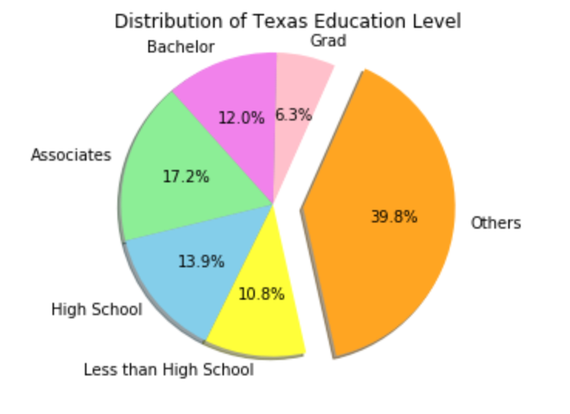
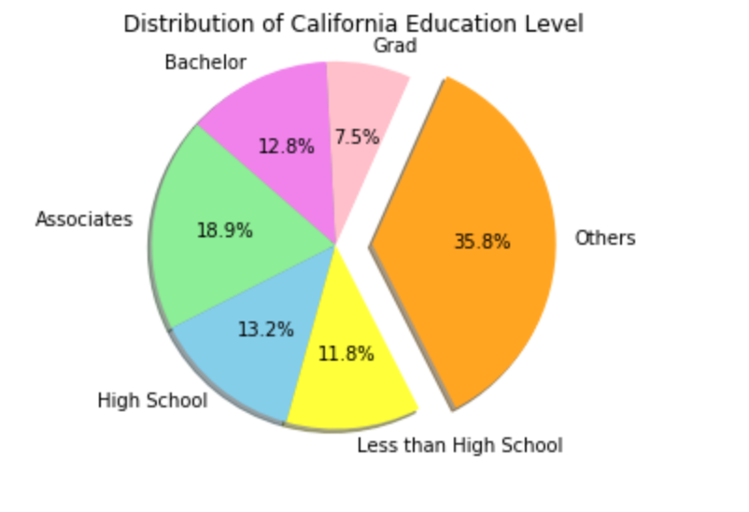
Education Level
Top 2 states: Average Death Rate Per Capita
Bottom 2 states: Average Death Rate Per Capita
Notes:
Jasmine

Slide 13
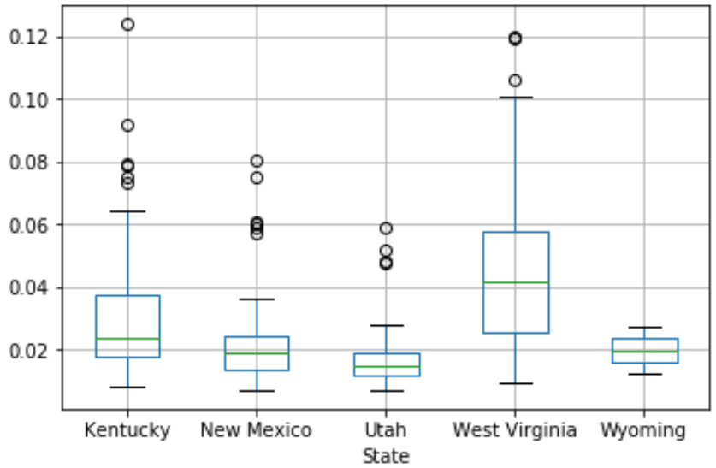
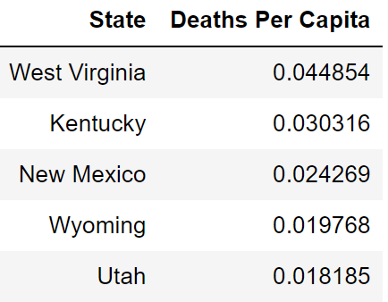
Top 5 States with the Highest Average Death Rate Per Capita
Notes:
Minhua

Slide 14
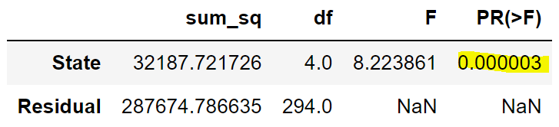
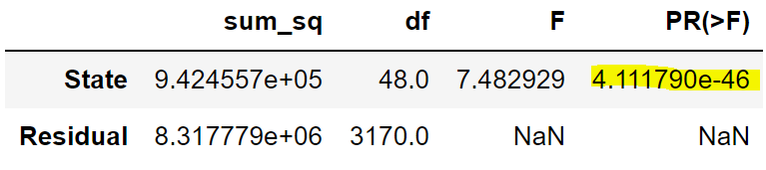
H₀: The death rates do not differ by states.
H_{a}: The death rates differ by states.
Ordinary Least Squares (OLS) model analyzing the TOP 5 states*
Ordinary Least Squares (OLS) model analyzing ALL the states
*Top 5 states: WV, KY, NM, WY, and UT.
Conclusion: Since the p-value is less than 0.05, we reject the null hypothesis and conclude that significant difference does exist in the death rates by states.
Notes:
Minhua

Slide 15
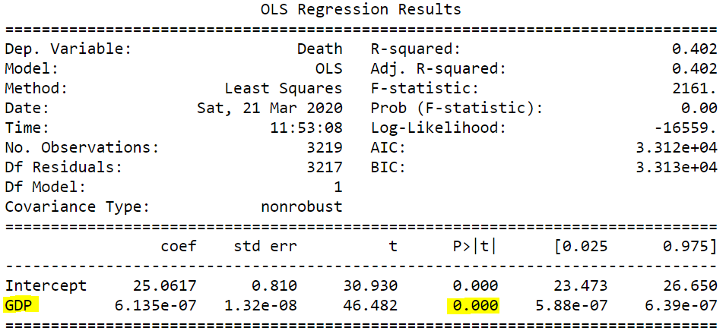
H₀: The death rates do not differ by GDP.
H_{a}: The death rates differ by GDP.
Conclusion: Since the p-value is less than 0.05, we reject the null hypothesis and conclude that significant difference does exist in the death rates by GDP.
Notes:
Minhua

Slide 16
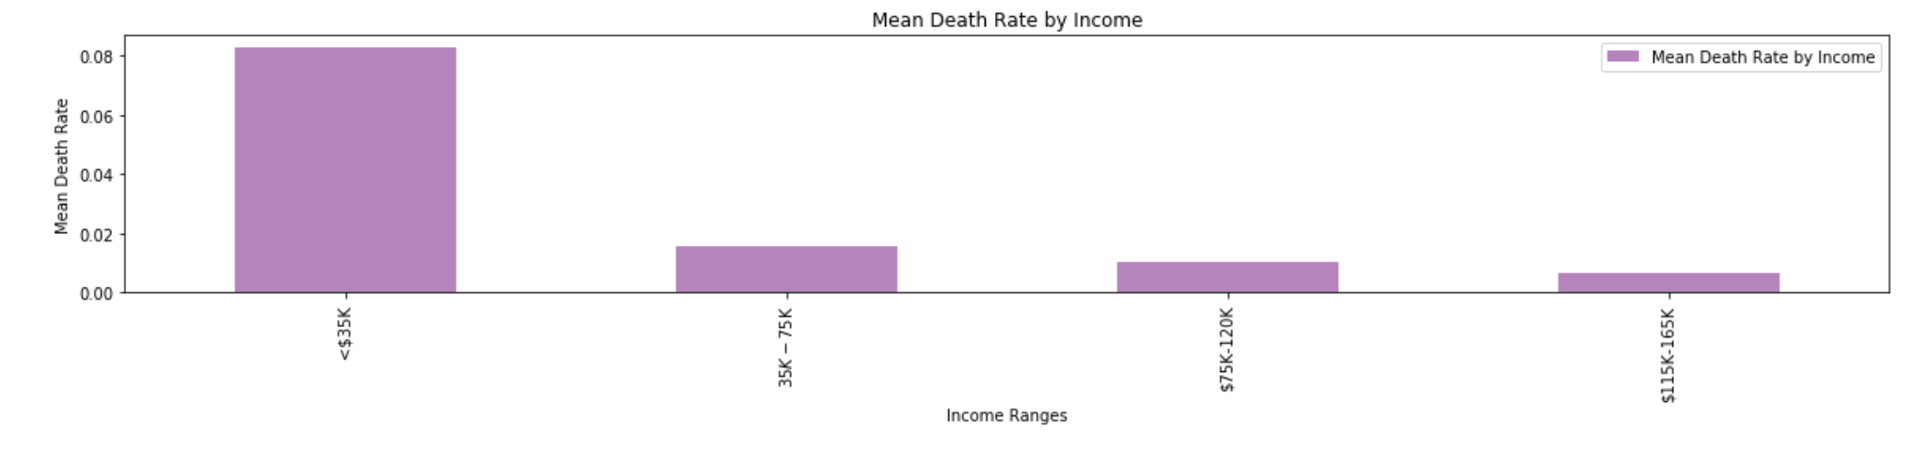
Mean Death Rate by Income
Observation: Mean death rate decreases with higher income range, with highest rate at $<35K range
Notes:
Rachael

Slide 17
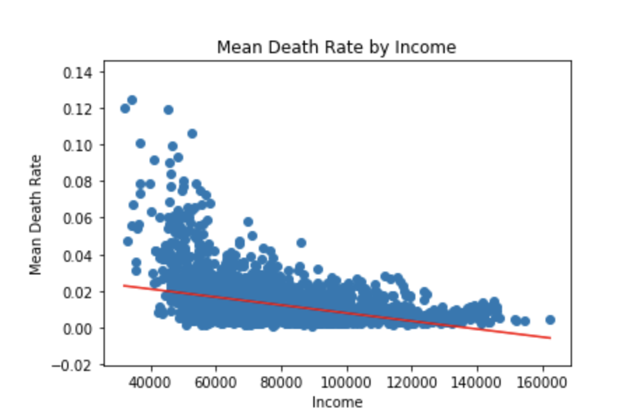
Linear Regression of Mean Death Rate by Income
The r-squared is: -0.3669957140120881
Weak negative association between income and mean death rate
Notes:
Rachael

Slide 18
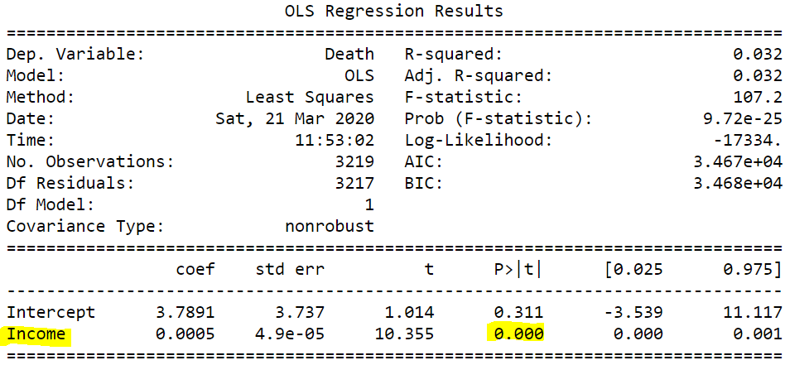
H₀: The death rates do not differ by income.
H_{a}: The death rates differ by income.
Conclusion: Since the p-value is less than 0.05, we reject the null hypothesis and conclude that significant difference does exist in the death rates by income.
Notes:
Minhua

Slide 19
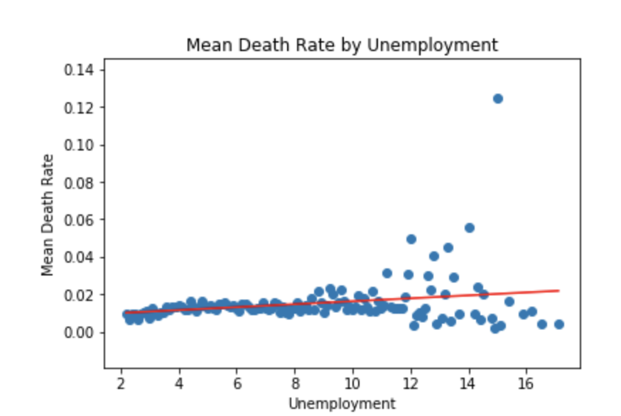
Linear Regression of Mean Death by Unemployment
Weak positive association between Unemployment and Mean Death Rate
The r-squared is: 0.24339843184589507
Notes:
Rachael

Slide 20
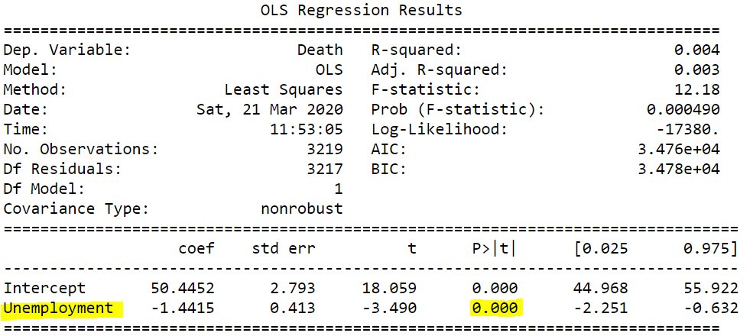
H₀: The death rates do not differ by unemployment rate.
H_{a}: The death rates differ by unemployment rate.
Conclusion: Since the p-value is less than 0.05, we reject the null hypothesis and conclude that significant difference does exist in the death rates by unemployment rate.
Notes:
Minhua

Slide 21
Conclusions
Ancillary Analysis on the Prescriber data to see which speciality was prescribing the highest Opioid prescriptions.
States that had higher death rate had less people with bachelor degree or higher, while states that had lower death rate had more people with bachelor degree or higher.
According to this dataset, West Virginia has the highest death rate per capita.
Based on the results of the hypothesis test (p-value < 0.05), we conclude that death rates do differ by state, year, income, employment rate, and GDP. Thus we are rejecting our null hypotheses.
Notes:
Rachael
This project helped us to better understand the variables we were assessing so make a more informed assessment/interpretation. Based on our results, people most affected tended to be ones with lower income, lower educational degrees, and higher unemployment. This may be a product of extended drug use but is important information to know to better target the population for interventions. Also, states highly affected was West Virginia, which is also an important consideration for targeted interventions.

